Slide 1


Efficient weighted probabilistic frequent itemset mining in UNCERTAIN DATABASE
-
Analysis and Design Algorithms-503040
Instructor: Ph.D. Nguyen Chi Thien
Doan Ngoc Nam - 52000084

Slide 2
Table of content
Introduction to Problem
Define Problem
Implement
Experiences

Slide 3
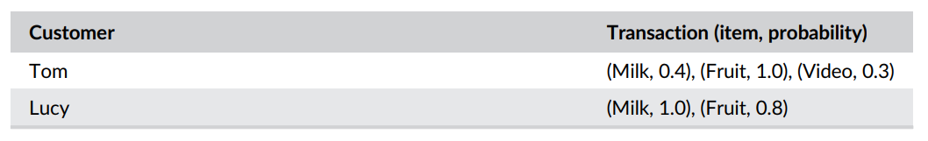


Introduction to problem (1)
Uncertain database become an active research direction
Traffic data analysis, monitoring, FI mining
Useful to understand customer behaviours
Inapplicable or inaccurate

Slide 4
Introduction to problem (2)
Overcome problem:
Binarize to certain database with threshold
Expectation support
Frequentness probability
=> Less efficient and economic. Treat items to get importance information

Slide 5
Introduction to problem (3)
W-PFIs :
Add weight to each item of transactions
No anti-monotonicity

Slide 6
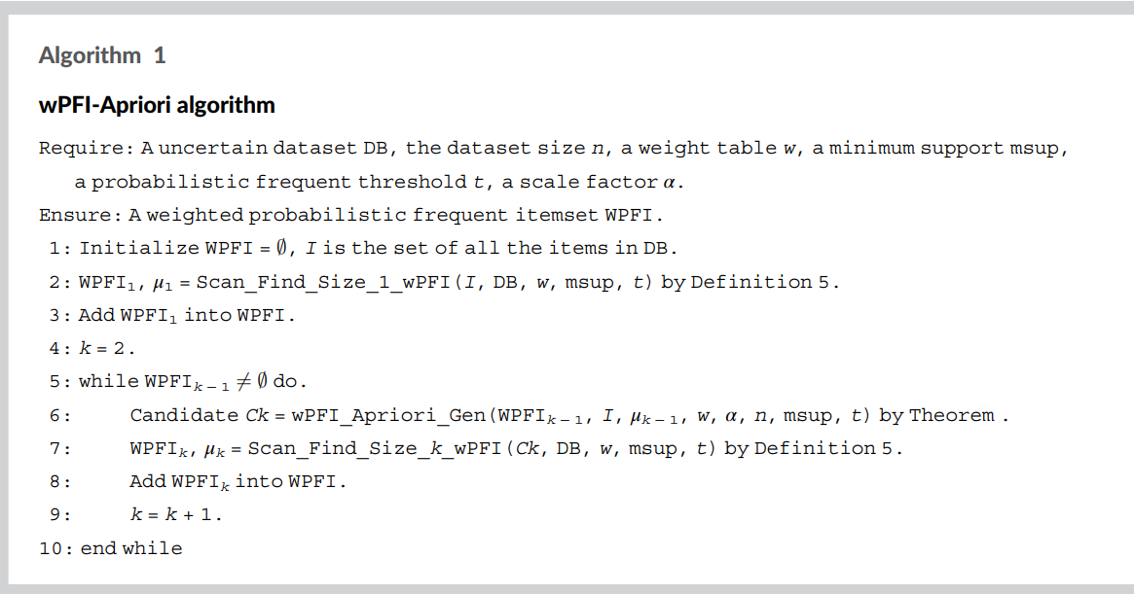
Define problem: Algorithm 1 – APRIORI (1)

Slide 7
Define problem: Algorithm 1 – APRIORI (1)
Input:
An uncertain database DB: List of dictionaries: [{}]
Weight table w: Dictionary {}
Minimum support msup: integer number
Threshold t: Float number
Alpha scare factor variable: Float number
Output:
WPFI contain w-PFI itemset: List of list [[]]

Slide 8
Define problem: Algorithm 1 – APRIORI (2)
2 small algorithms (function): Scan_Find_wPFI and wPFI_Apriori_Gen
With Scan_Find_wPFI:
Input:
Candicate set for scan: {}
List of transction with probability: [{}]
Weight table: dictionary {}
Minimum support : integer number
Threshold t: float number
Output:
List of itemset is w-PFI: [[]]

Slide 9
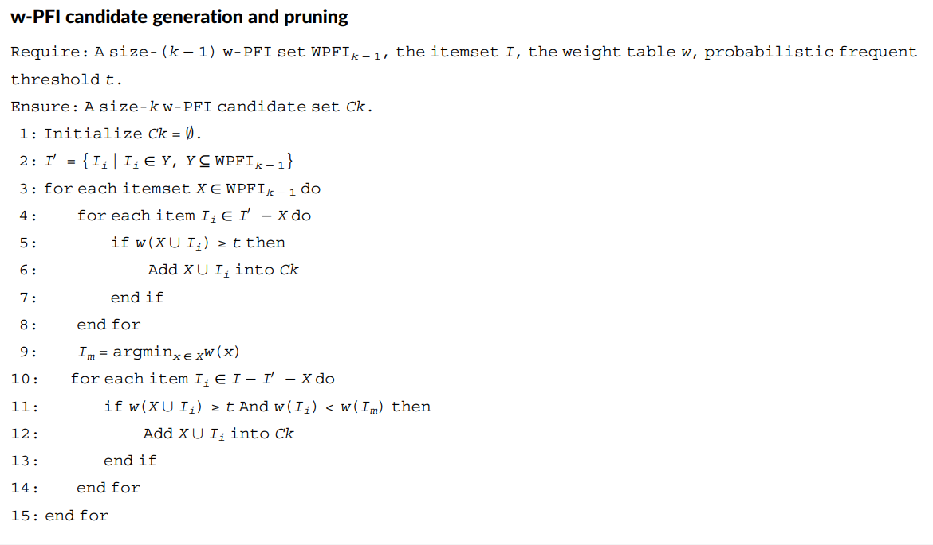
Define problem: Algorithm 2 – w-PFI candidate generation(1)

Slide 10
Define problem: Algorithm 2 – w-PFI candidate generation(2)
W-PFI GENERATE CANDICATE
Input:
W-PFI set size k-1: List []
Itemset I: set ()
Weight table: dictionary {}
Threshold t: float number
Output:
A w-PFI candidate size k-1 Ck: List []

Slide 11
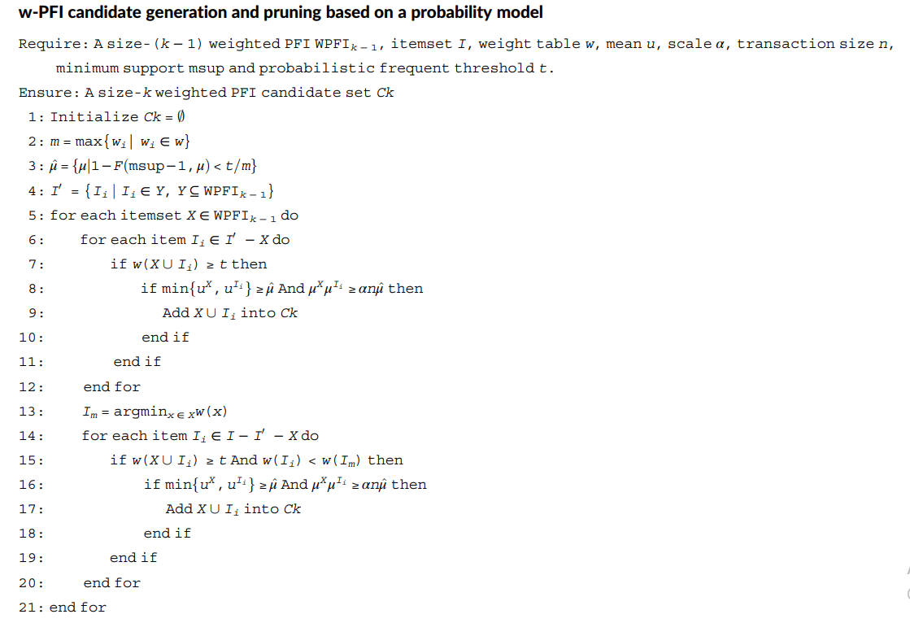
Define problem: Algorithm 3 – w-PFI candidate generation based on probability model (1)

Slide 12
Define problem: Algorithm 2 – w-PFI candidate based on probability model
Input:
W-PFI set size k-1: List []
Itemset I: set ()
Weight table: dictionary {}
Scale alpha: float number
Transaction size n: List []
Minimum support: float number
Threshold t: float number
Output:
A w-PFI candidate size k-1 Ck: List []

Slide 13
Implementation

Slide 14
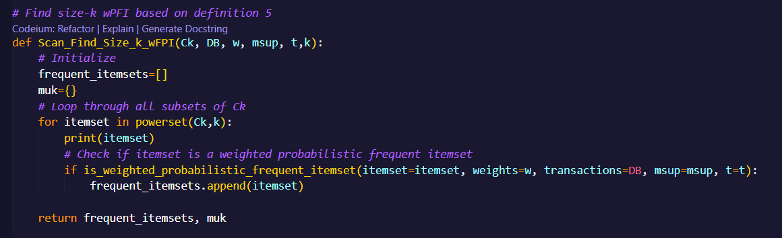
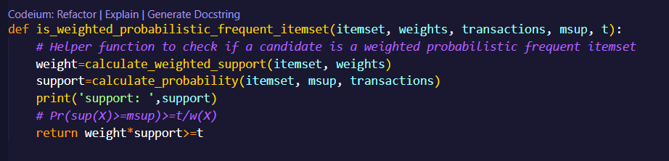
IMplement: SCAN_FIND_WPFI

Slide 15
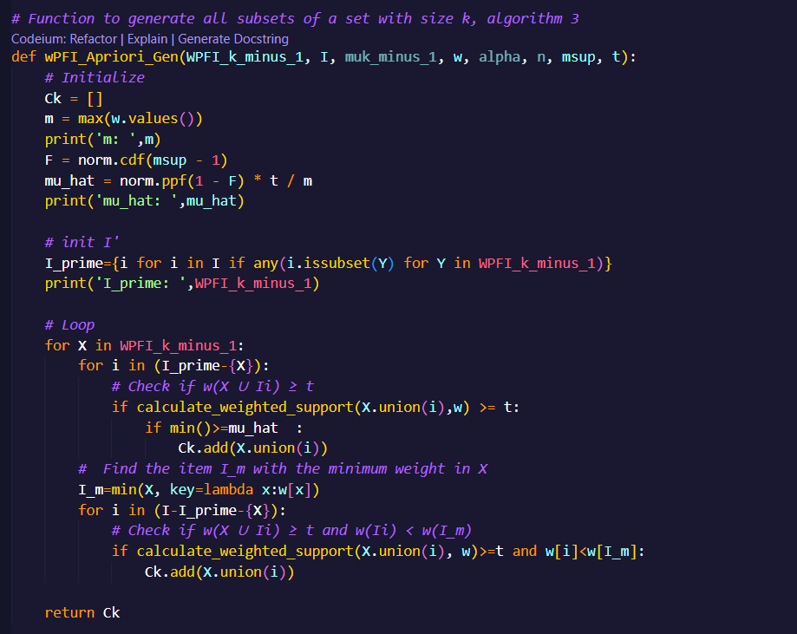
IMplement: GENERATE CADIDATE WPFI

Slide 16
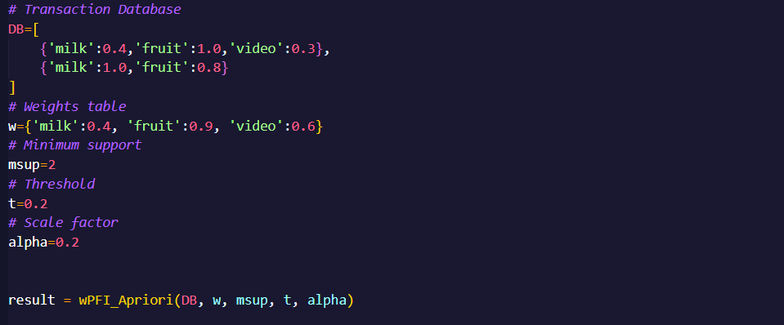
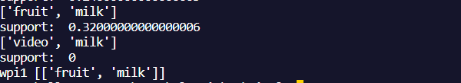
SAMPLE RUN : X={Fruit, milk} sp=0.32 is a w-pfi

